Slide 1

Vel Tech Rangarajan Dr. Sagunthala R&D Institute of Science and Technology
School of Computing
Department of Computer Science and Engineering
10211CS224 / FULL STACK APPLICATION DEVELOPMENT (JAVA)
PROJECT REVIEW : MILESTONE PROJECT – 1
Date:23-03-2026
Relational Inventory Control & Stock Tracking System
SDG: SDG No – SDG Title(Example: SDG 4 – Quality Education)
Presented By:
K.SAI VINAY – VTU24735 –23UECS1111
Courses Handling Faculty:
DR.Nateshan N.V.S

Slide 2
INTRODUCTION
Many colleges conduct events like technical fests, seminars, and workshops.
Ticket booking is often done manually or through unorganized methods.
This leads to errors, overbooking, and poor management.
A digital system helps automate event registration and ticket booking.
This project uses React JS for a modern web interface.
Users can view event details and book tickets easily.
Admin can manage events and track bookings efficiently.
The system improves accuracy, speed, and user experience.
1
2
3
4
5
6
7
8
9

Slide 3

PROBLEM STATEMENT
Existing systems for event ticket booking are not fully automated.
Manual booking leads to data errors and confusion.
No centralized system to manage event details and ticket availability
.
Difficulty in tracking booked tickets and users.
Time-consuming process for both users and organizers.
Lack of real-time updates on ticket availability.
Need for a reliable and user-friendly web-based system.
The solution should automate booking and improve efficiency.
1
2
3
4
5
6
7
8
9

Slide 4
OBJECTIVE(S)
1
To design and develop a React JS based ticket booking web application.
To implement secure user login and ticket booking system.
To improve efficiency in event management and booking process.
To provide real-time ticket availability and booking confirmation.
2
3
4
5
6
7
8
9

Slide 5
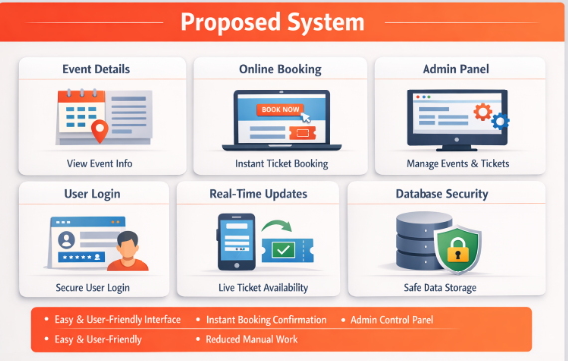
PROPOSED SYSTEM
Users can view all event details (name, date, venue, price).
Online ticket booking with instant confirmation.
Login system for students and faculty.
Admin panel to manage events and tickets
Real-time update of available tickets.
Easy and user-friendly interface using React JS.
Secure data storage using database.
Reduces manual work and errors.
1
2
3
4
5
6
7
8
9

Slide 6
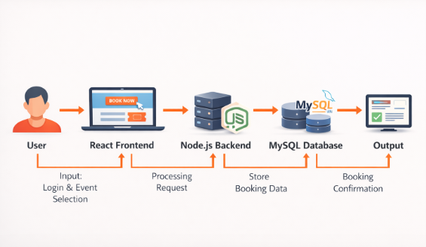
PROPOSED SYSTEM ARCHITECTURE
1
2
3
4
5
6
7
8
9

Slide 7
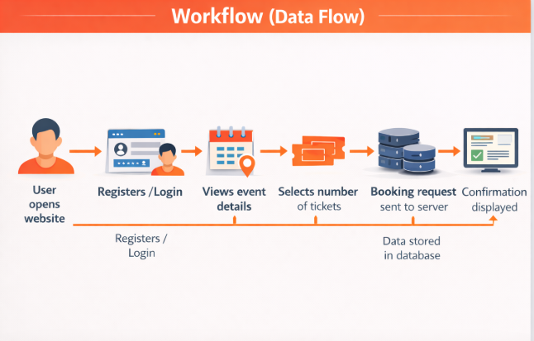
WORKFLOW
1
2
3
4
5
6
7
8
9

Slide 8
TECHNOLOGIES USED
Frontend: React JS, HTML, CSS, JavaScript
Backend: Node.js, Express.js
Database: MySQL
Tools: VS Code, Postman, Browser
Hardware/Software:
PC/Laptop
Internet connection
Node.js installed
1
2
3
4
5
6
7
8
9

Slide 9
MODULE DESCRIPTION
1
Module 1: User Management
Handles user registration and login authentication.
Module 2: Event Management
Displays event details like date, venue, and ticket price.
Module 3: Ticket Booking
Allows users to select and book tickets online.
Module 4: Database Management
Stores user, event, and booking data securely.
2
3
4
5
6
7
8
9

Slide 10
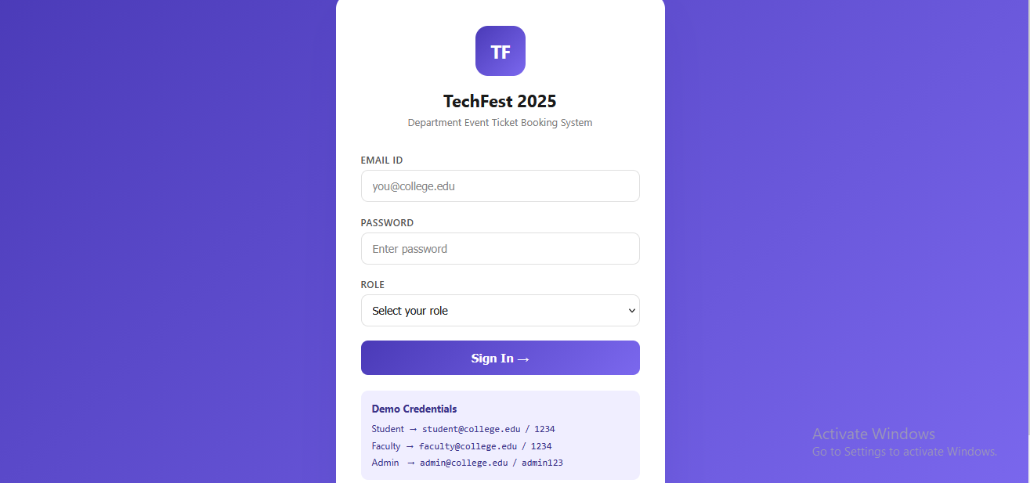
IMPLEMENTATION SCREENSHOTS
1
2
3
4
5
6
7
8
9

Slide 11
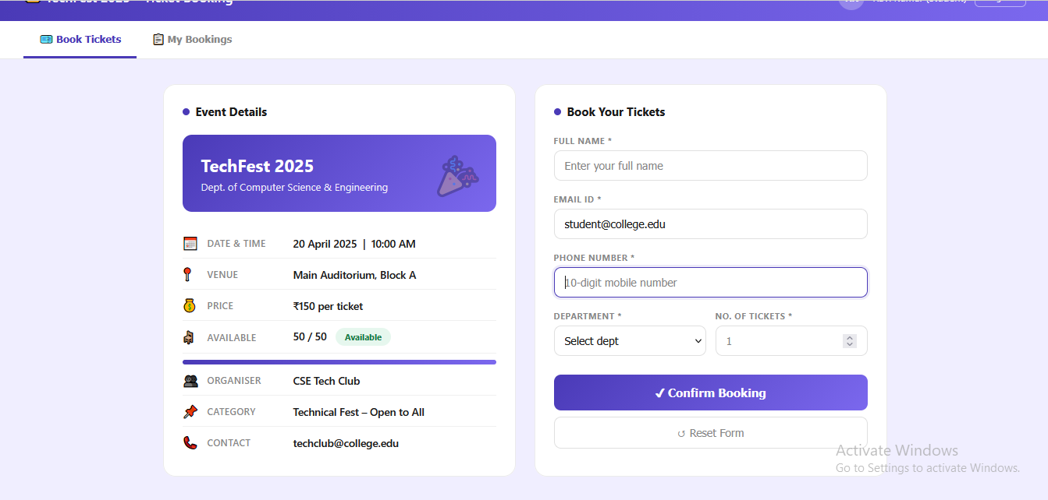
IMPLEMENTATION SCREENSHOTS
1
2
3
4
5
6
7
8(A)
9

Slide 12
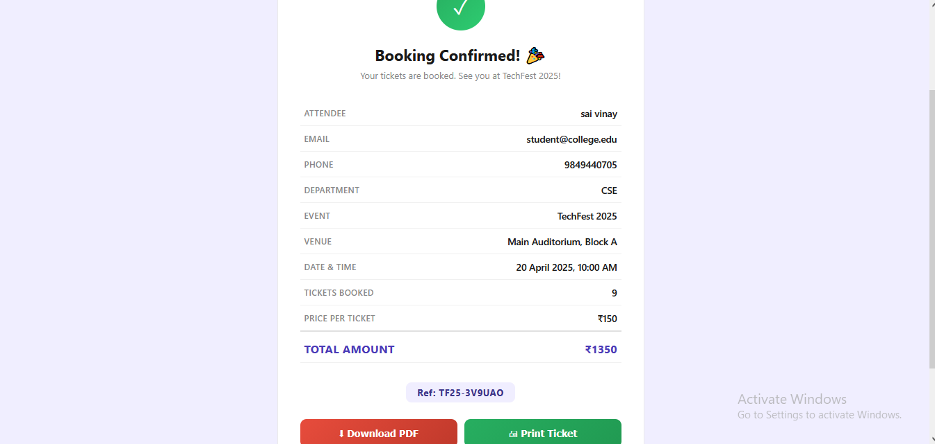
IMPLEMENTATION SCREENSHOTS
1
2
3
4
5
6
7
8(B)
9

Slide 13
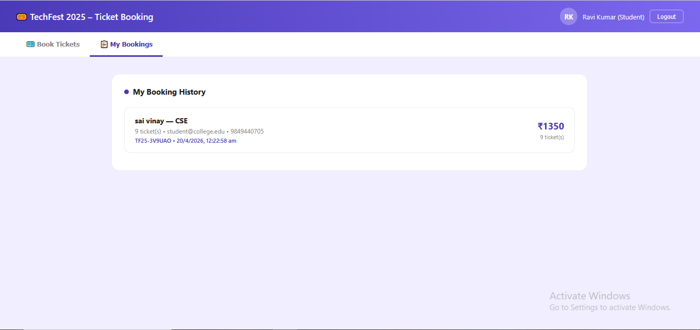
IMPLEMENTATION SCREENSHOTS
1
2
3
4
5
6
7
8(C)
9

Slide 14
ADVANTAGES & LIMITATIONS
1
✅ Advantages
1.Easy to use interface
2.Saves time and effort
3. Reduces manual errors
4. Real-time ticket updates
2
3
4
5
6
❌ Limitations
Requires internet connection
Basic security (can be improved)
Limited to internal department use
7
8
9

Slide 15
Thank you

